Slide 1

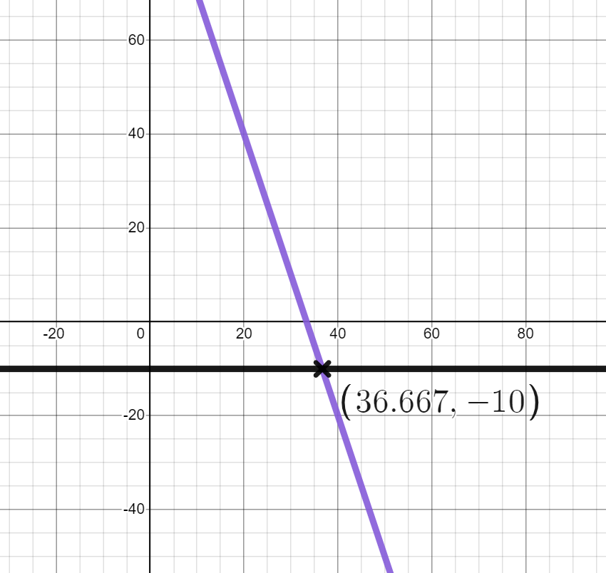

Graphing special number sequences using technology
Task A: Plotting sequences using Desmos
Lucas wants to know if −10 is in the sequence 100 − 3n
I have plotted the lines y = 100 − 3n and y = −10. They intersect so −10 is a term in the sequence 100 − 3n
a) What has Lucas done correctly?
Lucas
b) Explain to Lucas what mistake he has made.
2) Use Desmos to match these sequences to their n^{th} term rules
a) Geometric sequence with first five terms: 2, 4, 8, 16, 32, …
4 × 3^{n}
b) Geometric sequence with first five terms: 8, 16, 32, 64, 128, …
3 × 2^{n}
c) Geometric sequence with first five terms: 6, 12, 24, 48, 96, …
2 × 3^{n}
d) Geometric sequence with first five terms: 6, 18, 54, 162, 486, …
2^{n}
e) Geometric sequence with first five terms: 12, 36, 108, 324, 972, …
2^{n + 2}

Slide 2
Graphing special number sequences using technology
3) Use graphing software to help with the following questions.
a) Is the number 30 in this sequence?
Term number | 1 | 2 | 3 | 4 | n
Term | −1.5 | 0.6 | 2.7 | 4.8 | 2.1n − 3.6
b) Is the number 2044 in this sequence?
Term number | 1 | 2 | 3 | 4 | n
Term | 8 | 24 | 72 | 216 | 8 × 3^{n − 1}
c) Is the number 1280 in this sequence?
Term number | 1 | 2 | 3 | 4 | n
Term | 10 | 20 | 40 | 80 | 5 × 2^{n}
d) Is the number 4004 in this sequence?
Term number | 1 | 2 | 3 | 4 | n
Term | 4 | 16 | 64 | 256 | 4^{n}
Task B: Exploring special number sequences
1a) Plot the first 20 points of the sequences 2n, n² and 2^{n}
b) Two of the sequences have the same first term, which two?
c) What is happening at the coordinate (2,4) what does this mean about the sequences?
d) Which sequence is increasing at the fastest rate?
e) Find four numbers which are in the sequence 2n and 2^{n}
f) What is the 15th term in the sequence 2^{n} ?

Slide 3
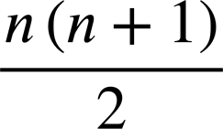
Graphing special number sequences using technology
2a) Plot the first 20 points of the sequences 5 − n², 5 + n² and n³− 5
b) Which sequence has the smallest 1st term?
c) Which sequence has the smallest 2nd term?
d) Which sequence has the largest 3rd term?
e) What do you notice about the sequences 5 + n² and 5 − n²?
3a) The sequence of all triangular numbers has the n^{th} term rule
plot the first 20 terms.
b) What is the 19th triangular number?
c) The geometric sequence which starts 1, 2, 4, 8,... has the n^{th} term rule 2^{n − 1}
at what term number does this sequence overtake the triangular numbers?
e) Which is larger the 8th term in the sequence 2^{n − 1} or the 16th triangular number.
4a) A sequence starts 1, 3, 4, … the next term is found by adding the two previous terms together. Plot the first 10 terms of this sequence.
b) A different sequence starts 1, −3, … the next term is found by adding the two previous terms together. Plot the first 10 terms of this sequence.
c) How does the shape of the graph of this sequence differ to the previous one?
Mathematics in Education and Industry.
3
v2.3

